Slide 1
Project Phase 2
By Erick Perez Valiente
March 5, 2023

Slide 2
Purpose
The main purpose of this PowerPoint is to present our findings on the dataset provided to us, to show what factors are important in determining if a home was sold above the median price or not.
These findings will help us have a better understanding on what influences home prices.

Slide 3
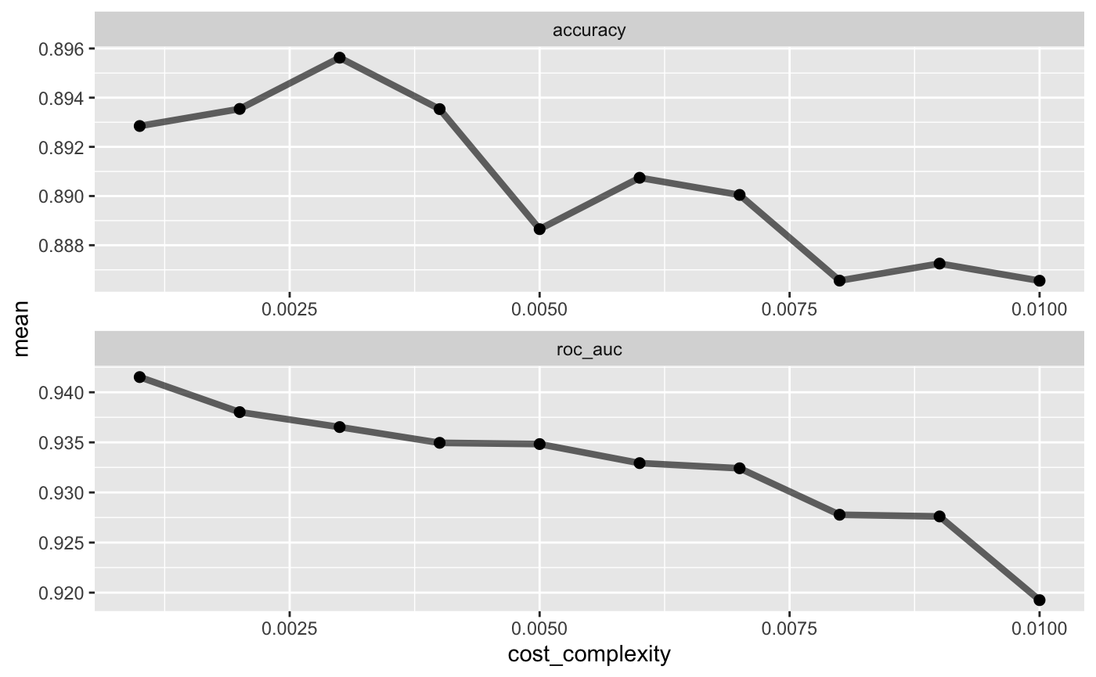
Are our models Accurate?
After creating and running a confusion matrix, we determined that our model was 88.15% accurate with a Specificity of 90.76%.
With this model we can create a very accurate tree plot.

Slide 4
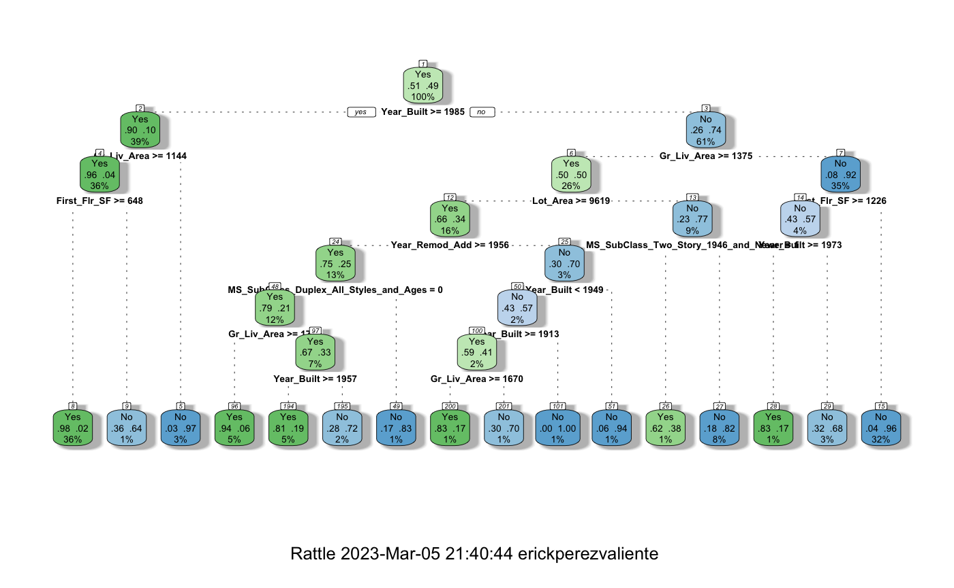
Tree Plot Results
This tree plot provides a great breakdown on the factors and whether they affect the “Above Median” factor we used as the predictor.
For Example- 51% of homes built after 1985 were sold above the median price, from there if the living area was over 1144, then 90% of those homes were above the median price and so on.

Slide 5
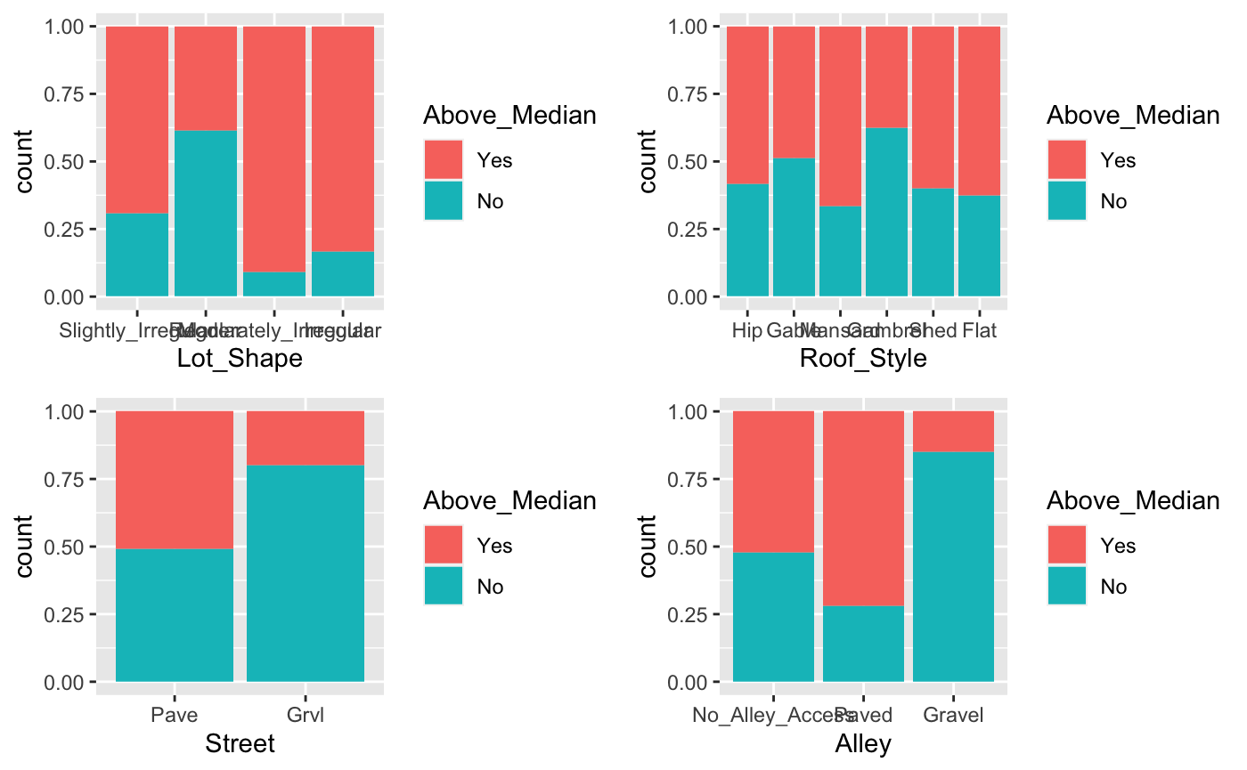
Breakdown of Factors vs Above Median Bar
From the bar graphs seen here, we are determining which variable in each factor has the biggest effect on the above median price.
From what we can see here- Street and Alley seem to be the two variables with the biggest difference. It seems that Gravel streets and Alley’s are big determining factors on whether a house was sold above the median price. Over 75% of houses with either a gravel street or alley did not sell above the median price.

Slide 6
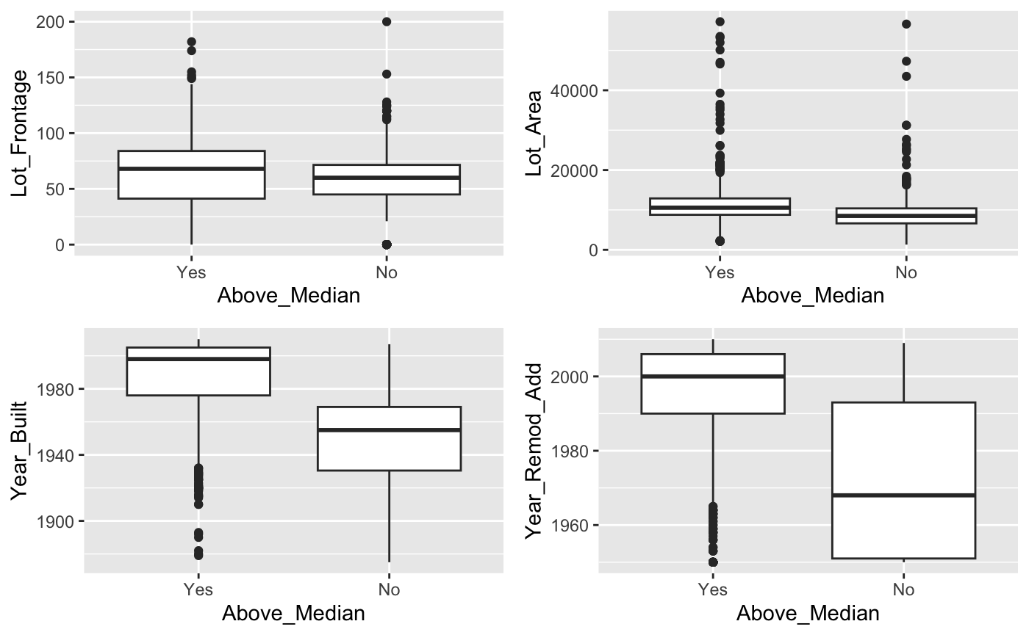
Breakdown of Factors vs Above Mean Boxplot
These boxplots are another method to determining which factors and variables play a big part in whether a house sold above the median price.
As we can see in the boxplots, the Year the house was built and the Year the house was remodeled was a big determining factor.
If a house was built after 1980 or if it was remodeled after 1990, then it seems that it was sold above the median price.

Slide 7
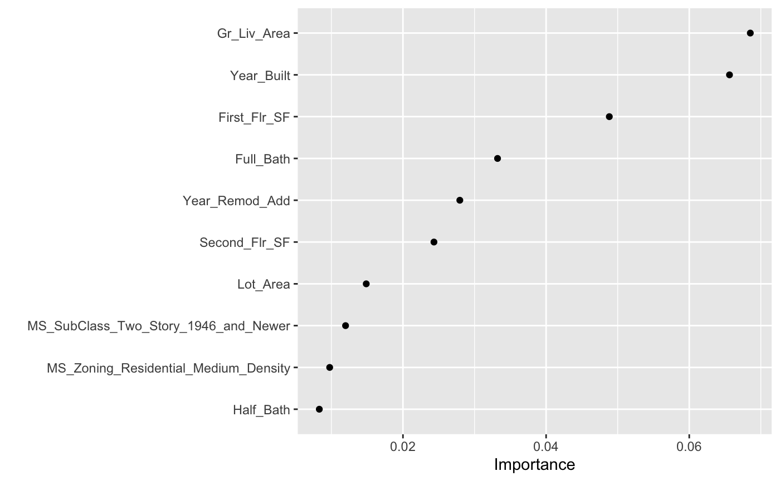
What are the biggest determining factors?
In my opinion, a random forest is the best way to determine the most important factors
Based on our random forest model, we can see that that Living Area is the most important factor on the above median price, followed by the year that it was built. The are most important by a large margin compared to the rest of the factors.
The least important factors are the Zoning Residential Density and whether it had a half bath.

